Slide 1
Chapter 13
Central Banks and the Federal Reserve System

Slide 2
The Price Stability Goal
Low and stable inflation
Inflation
  Creates uncertainty and difficulty in planning for the future
  Lowers economic growth
  Strains social fabric
Nominal anchor to contain inflation expectations
Time-inconsistency problem

Slide 3
Other Goals of Monetary Policy
High employment
Economic growth
Stability of financial markets
Interest-rate stability
Foreign exchange market stability

Slide 4
Should Price Stability be the Primary Goal?
In the long run there is no conflict between the goals
In the short run it can conflict with the goals of high employment and interest-rate stability
Hierarchical mandate
Dual mandate

Slide 5
Origins of the Federal Reserve System
Resistance to establishment of a central bank
  Fear of centralized power
  Distrust of moneyed interests
No lender of last resort
  Nationwide bank panics on a regular basis
  Panic of 1907 so severe that the public was convinced a central bank was needed
Federal Reserve Act of 1913
  Elaborate system of checks and balances
  Decentralized

Slide 6
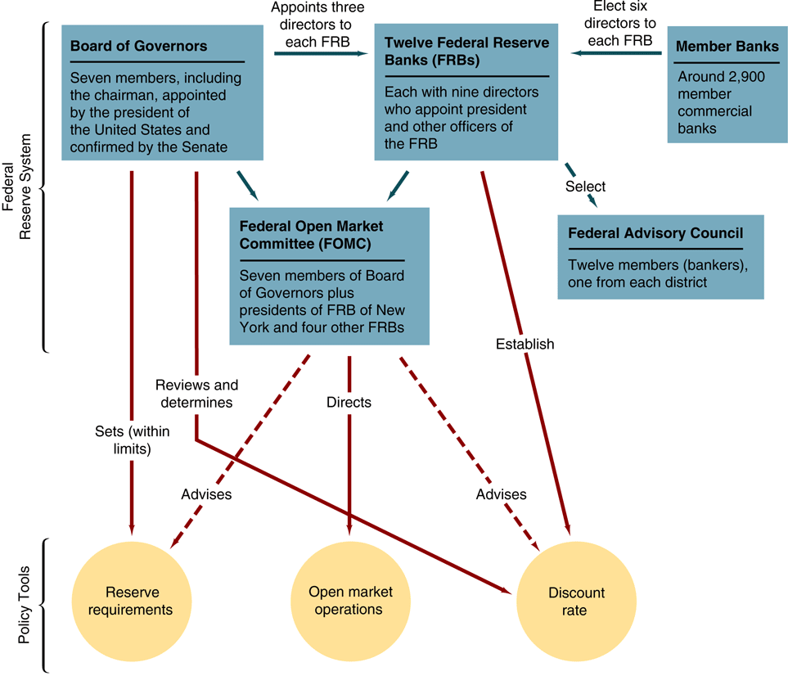
FIGURE 1 Structure and Responsibility for Policy Tools in the Federal Reserve System

Slide 7
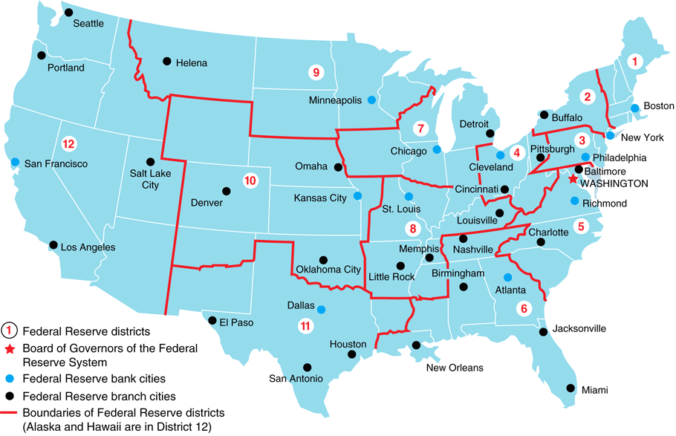
FIGURE 2 Federal Reserve System
Source: Federal Reserve Bulletin.

Slide 8
Federal Reserve Banks
Quasi-public institution owned by private commercial banks in the district that are members of the Fed system
Member banks elect six directors for each district; three more are appointed by the Board of Governors
  Three A directors are professional bankers
  Three B directors are prominent leaders from industry, labor, agriculture, or consumer sector
  Three C directors appointed by the Board of Governors
  are not allowed to be officers, employees, or stockholders
  of banks

Slide 9
Federal Reserve Banks (cont’d)
Member banks elect six directors for each district; three more are appointed by the Board of Governors (cont’d)
  Designed to reflect all constituencies of the public
Nine directors appoint the president of the bank subject to approval by Board of Governors

Slide 10
Functions of the Federal Reserve Banks
Clear checks
Issue new currency
Withdraw damaged currency from circulation
Administer and make discount loans to banks in their districts
Evaluate proposed mergers and applications for banks to expand their activities

Slide 11
Functions of the Federal Reserve Banks (cont’d)
Act as liaisons between the business community and the Federal Reserve System
Examine bank holding companies and state-chartered member banks
Collect data on local business conditions
Use staffs of professional economists to research topics related to the conduct of monetary policy

Slide 12
Federal Reserve Banks and Monetary Policy
Directors “establish” the discount rate
Decide which banks can obtain discount loans
Directors select one commercial banker from each district to serve on the Federal Advisory Council which consults with the Board of Governors and provides information to help conduct monetary policy
Five of the 12 bank presidents have a vote in the Federal Open Market Committee (FOMC)

Slide 13
Member Banks
All national banks are required to be members of the Federal Reserve System
Commercial banks chartered by states are not required but may choose to be members
Depository Institutions Deregulation and Monetary Control Act of 1980 subjected all banks to the same reserve requirements as member banks and gave all banks access to Federal Reserve facilities

Slide 14
Board of Governors of the Federal Reserve System
Seven members headquartered in Washington, D.C.
Appointed by the president and confirmed by the Senate
14-year non-renewable term
Required to come from different districts
Chairman is chosen from the governors and serves four-year term

Slide 15
Duties of the Board of Governors
Votes on conduct of open market operations
Sets reserve requirements
Controls the discount rate through “review and determination” process
Sets margin requirements
Sets salaries of president and officers of each Federal Reserve Bank and reviews each bank’s budget

Slide 16
Duties of the Board of Governors (cont’d)
Approves bank mergers and applications for new activities
Specifies the permissible activities of bank holding companies
Supervises the activities of foreign banks operating in the U.S.

Slide 17
Chairman of the Board of Governors
Advises the president on economic policy
Testifies in Congress
Speaks for the Federal Reserve System to the media
May represent the U.S. in negotiations with foreign governments on economic matters

Slide 18
Federal Open Market Committee (FOMC)
Meets eight times a year
Consists of seven members of the Board of Governors, the president of the Federal Reserve Bank of New York and the presidents of four other Federal Reserve banks
Chairman of the Board of Governors is also chair of FOMC
Issues directives to the trading desk at the Federal Reserve Bank of New York

Slide 19
FOMC Meeting
Report by the manager of system open market operations on foreign currency and domestic open market operations and other related issues
Presentation of Board’s staff national economic forecast
Outline of different scenarios for monetary policy actions
Presentation on relevant Congressional actions
Public announcement about the outcome of the meeting

Slide 20
Why the Chairman Really Runs the Show
Spokesperson for the Fed and negotiates with Congress and the President
Sets the agenda for meetings
Speaks and votes first about monetary policy
Supervises professional economists
and advisers

Slide 21
How Independent is the Fed?
Instrument and goal independence.
Independent revenue
Fed’s structure is written by Congress, and is subject to change at any time.
Presidential influence
  Influence on Congress
  Appoints members
  Appoints chairman although terms are not concurrent

Slide 22
European Central Bank
Patterned after the Federal Reserve
Central banks from each country play similar role as Fed banks
Executive Board
  President, vice-president and four other members
  Eight year, nonrenewable terms
Governing Council

Slide 23
Differences
National Central Banks control their own budgets and the budget of the ECB
Monetary operations are not centralized
Does not supervise and regulate financial institutions

Slide 24
Governing Council
Monthly meetings at ECB in Frankfurt, Germany
Twelve National Central Bank heads and
six Executive Board members
Operates by consensus
ECB announces the target rate and takes questions from the media
To stay at a manageable size as new countries join, the Governing Council will
be on a system of rotation

Slide 25
ECB Independence
Most independent in the world
Members of the Executive Board have long terms
Determines own budget
Less goal independent
  Price stability
Charter cannot by changed by legislation; only by revision of the Maastricht Treaty

Slide 26
Structure and Independence of Other Foreign Central Banks
Bank of Canada
Governors appointed by Govt for three years
Four Deputy Governors
Ministry of Finance
Essentially controls monetary policy
Bank of England
Chancellor of the Exchequer
  Has some instrument independence.
Bank of Japan
  Recently (1998) gained more independence
The trend toward greater independence

Slide 27
Central Bank Behavior
Theory of bureaucratic behavior:
objective is to maximize its own welfare which is related to power and prestige
  Fight vigorously to preserve autonomy
  Avoid conflict with more powerful groups
Does not rule out altruism

Slide 28
Case for Independence
Political pressure would impart an inflationary bias to monetary policy
Political business cycle
Could be used to facilitate Treasury financing of large budget deficits: accommodation
Too important to leave to politicians—the principal-agent problem is worse for politicians

Slide 29
Case Against Independence
Undemocratic
Unaccountable
Difficult to coordinate fiscal and monetary policy
Has not used its independence successfully

